Slide 1
Growth Mindset day 2
Room 123

Slide 2
Finish Four 4’s Activity (10 – 12 minutes)
Groups of 3 – 4
Create a list from 1–20 in which you use four 4s and any math operation

Slide 3
1 11
2 12
3 13
4 14
5 15
6 16
7 17
8 18
9 19
10 20

Slide 4
What is the largest number you can create? What is the smallest?
Can you use Four 4’s to make negative numbers?
How many number’s can you create with Five 5’s?

Slide 5
Reflection (6 – 8 minutes) (write a few down on your board)
What things do you like people to say and/or do when you are working on a math problem in a group?
What things do you not like people to say and/or do when you are working on a math problem in a group?

Slide 6
Video (2 minutes)
https://bhi61nm2cr3mkdgk1dtaov18-wpengine.netdna-ssl.com/wp-content/uploads/2017/07/Day-2-Brain-Crossing.mp4

Slide 7
Patterns in Numbers (20 – 30 minutes)
Write each picture’s numeric representation.
What patterns stand out to you (and your group) in the following number line?
Create a list on your board.
Describe a pattern that your group discovered that was most interesting.

Slide 9
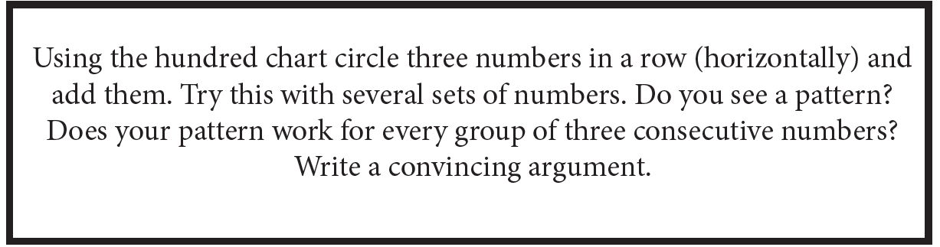

Slide 10
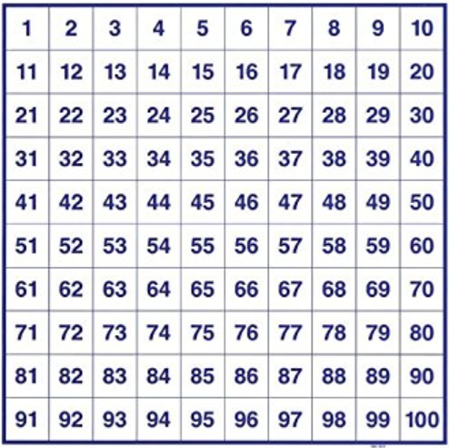

Slide 11
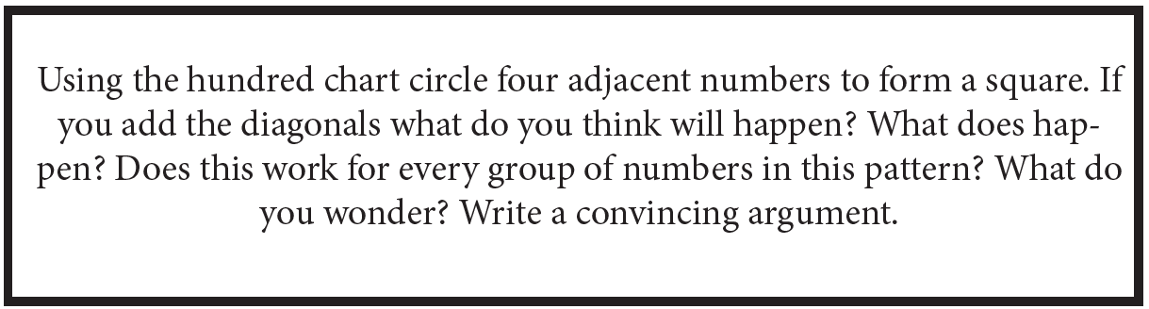

Slide 13
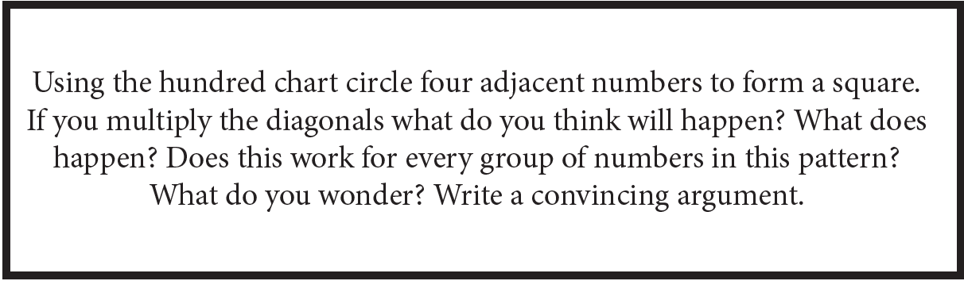

Slide 15
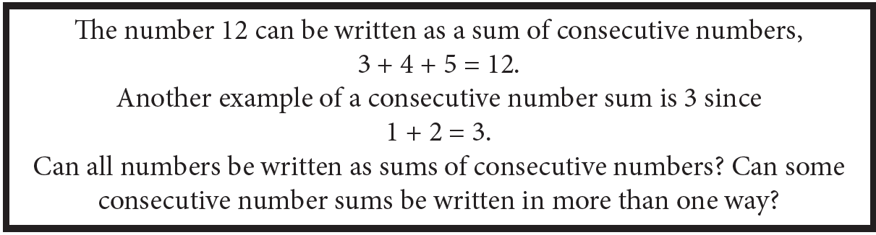

Slide 17
Pascal’s Triangle (20 – 30 minutes)
1.) Complete Pascal’s Triangle.
2.) Find the sum of each row in Pascal’s Triangle. Is there a pattern?
3.) Shade all of the odd numbers in Pascal’s Triangle. Is there a pattern?

Slide 18
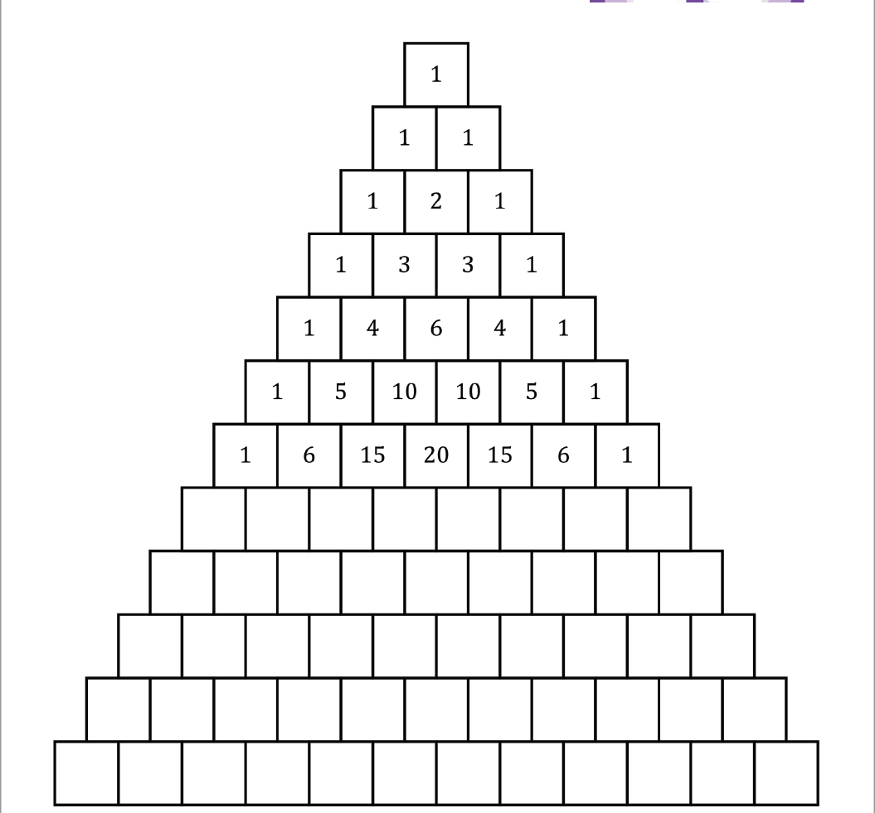

Slide 19
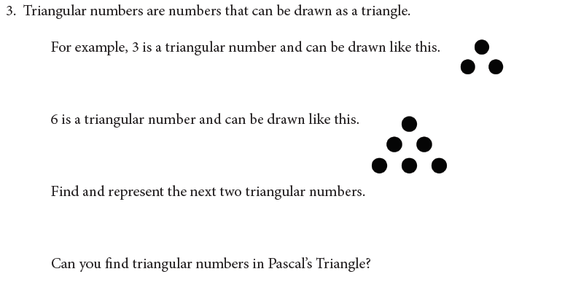
4.) Describe one more pattern that you discovered
within Pascal’s Triangle.

Slide 21
Exit Ticket
What do you want me to know about you in order to make this year the best year you’ve had in a math classroom?

